Slide 1









Unsupervised Visual Representation Learning by Graph-based Consistent Constraints
¹Dong Li
²Wei-Chih Hung
³Jia-Bin Huang
¹Shengjin Wang
³Narendra Ahuja
²Ming-Hsuan Yang
¹Tsinghua University
²University of California, Merced
³University of Illinois, Urbana-Champaign
http://bit.ly/feature-learning-eccv2016

Slide 2
Representation Learning
Supervised learning: Expensive annotations & Poor scalability
Human-labeled images
Image Recognition
Visual Representations
Goal: Visual representation learning with a large, unlabeled image collection
Unlabeled images
Image Recognition
Visual Representations
Notes:
Learning rich visual representations often requires massive amounts of human-labeled data.
The labeled data is expensive and does not scale up.
In this work, we address the problem of unsupervised visual representation learning. Given only a large, unlabeled image collection, we aim to learn rich visual representations for visual recognition.

Slide 3
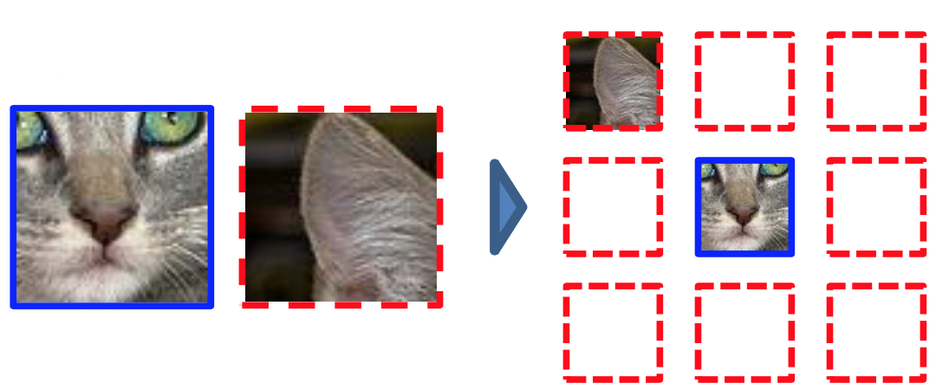
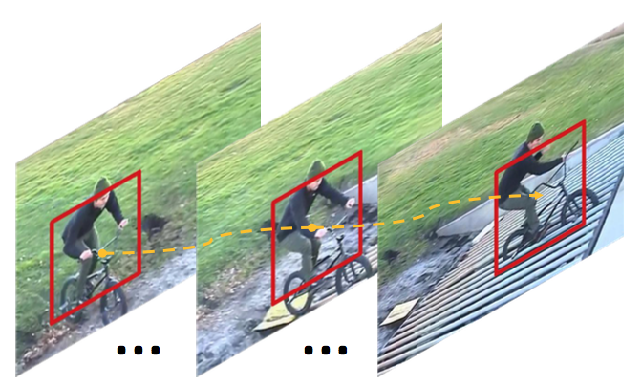
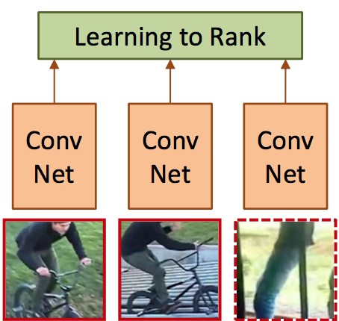
Prior Work - Representation Learning
Class labels [Krizhevsky et al. NIPS’12]
Web resources [Chen and Gupta ICCV’15; Joulin et al. ECCV’16]
Ego-motion [Agrawal et al. ICCV’15; Jayaraman et al. ICCV’15]
Context [Doersch et al. ICCV’15]
Tracking [Wang and Gupta ICCV’15]
Context: instances within the same image
Tracking: instances within the same video
instance-level training data
Notes:
Recently, various types of supervisory signals are exploited to learn visual representations as the substitutes for class labels.
The works of context [Doersch et al. ICCV’15] and tracking [Wang and Gupta ICCV’15] also aim to learn visual representations from a totally unlabeled image or video collection in the unsupervised fashion. However, they consider only instance-level data as the training samples are taken within the same image and video.

Slide 4
Main Idea - Mining
Mine category-level training samples across different images
Image pairs from the same class
Image pairs from the different classes
Positive pairs
Negative pairs
Unlabeled images
…
…
Notes:
In contrast to related work, we aim to mine category-level training samples across different images. These category-level samples contain positive image pairs that are from the same class but may have large intra-class appearance variations, and negative image pairs that are from the different classes but share visual similarities to an extent. Such training samples are crucial for learning effective visual representations.

Slide 5
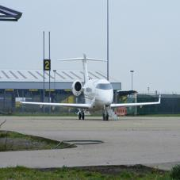
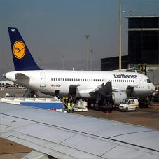
Main Idea - Training
Learn visual representations for binary classification
Positive pairs
Negative pairs
Same class?
Different classes?
Deep Networks
…
…
Notes:
Using the mined image pairs, we learn visual representations for binary classification, i.e., predicting whether two images belong to the same class. Although semantic labels of images are not available, we expect to extract semantics by learning to classify image pairs.

Slide 6
Positive Mining
Cycle consistency: positive pairs with large appearance variations
Unlabeled images
k-NN Graph
Positive mining
Similar appearances
Direct matching
Cyclic matching
Notes:
In this work, we propose a graph-based unsupervised constraint mining algorithm to mine positive and negative pairs.
We construct the k-nearest neighbor (k-NN) graph by representing each image as a node and each nearest-neighbor matching pair as an edge.
We propose to use a cycle consistency criterion for positive mining. By detecting cycles in the graph, we collect all the pairs in the cycles as positive samples.
Compared to direct matching, cycle consistency helps mine positive image pairs with large appearance variations.

Slide 7
Negative Mining
Geodesic distance: hard negative pairs with a relatively small L2 distance
Unlabeled images
k-NN Graph
Negative mining
Easy samples
Hard samples
Large L2 distance
Large geodesic distance
Notes:
We propose to use geodesic distance for negative mining. The geodesic distance between two images is computed along the shortest path in the graph. We select image pairs with large geodesic distance as negative samples.
Geodesic distance helps mine hard negative image pairs with a relatively small L2/Euclidean distance in the original feature space.

Slide 8
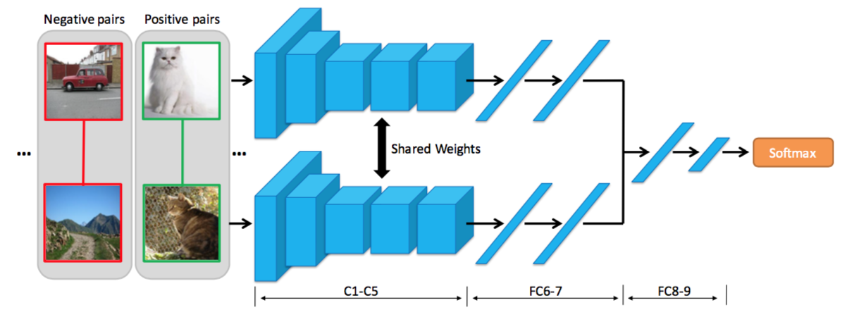
Pair-wise Training
Siamese network for binary pair classification
4096
4096
64
2
Notes:
To learn visual representations by the mined positive and negative pairs, we use a Siamese network for binary pair classification.
C1-FC7 layers follow the AlexNet architecture and share weights. FC8-9 layers have 64 and 2 neurons, respectively. A binary softmax classifier is used to predict whether two images belong to the same category.

Slide 9
Controlled Experiments (CIFAR-10)
Evaluation on positive mining
 | Random sampling | Direct matching | 2-cycle | 3-cycle | 4-cycle | 5-cycle
TP rate | 10.0 | 59.0 | 73.8 | 82.9 | 83.0 | 81.7
Accuracy | 73.7 | 78.0 | 79.9 | 80.5 | 80.9 | 80.2
Accurate positive pairs & Better CNN representations
Evaluation on negative mining
 | Random sampling | Original distance | Geodesic distance
TN rate | 90.0 | 95.5 | 91.0
Accuracy | 83.8 | 68.3 | 85.2
Easy samples
Hard samples
Notes:
Positive mining: We compare the proposed positive mining method with random sampling and direct matching for image classification on CIFAR-10. For fair comparisons, we sample the same set of true negative pairs for the three methods. In terms of true positive (TP) rate and classification accuracy, cycle consistency outperforms random sampling and direct matching. The results demonstrate that cycle consistency helps mine accurate pairs and learn better CNN representations.
Negative mining: We compare the proposed negative mining method with random sampling and original distance with the same set of true positive pairs. Using geodesic distance achieves better classification performance than that of using random sampling and original distance. Although more accurate pairs are mined by the original L2 distance, they are often easy negative samples and do not provide much information for learning effective representations.

Slide 10
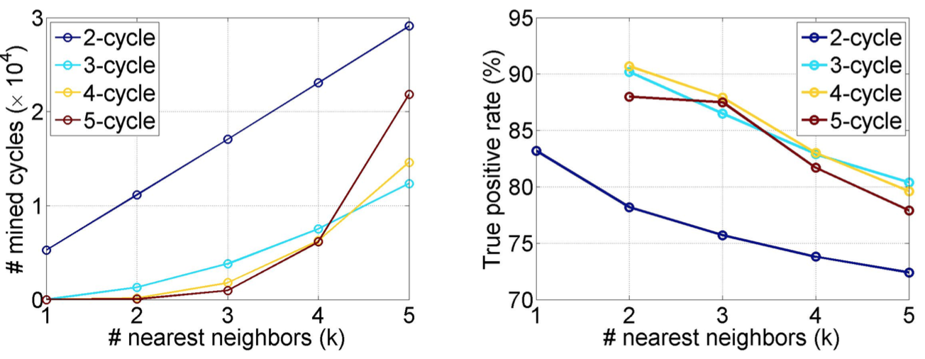
Controlled Experiments (CIFAR-10)
Parameter analysis
Effect of different features
Features | LBP | HOG | SIFT+FV | Pre-trained CNN
Accuracy | 76.7 | 80.7 | 80.9 | 81.6
Cycle consistency works well on different hand-crafted features.
Notes:
We show the statistics of mined cycles with different k (the number of nearest neighbors) and n (the length of cycle). As k increases, the amount of mined cycles increases because larger k results in more linked nodes, while the true positives rate drops due to the noise introduced by nearest neighbor matching.
We also evaluate different features for constructing the graph and obtain similar classification performance. The results show that cycle consistency works well on different hand-crafted features.

Slide 11
Applications
Unsupervised feature learning
Semi-supervised learning
Notes:
We validate the effectiveness of the proposed unsupervised constraint mining algorithm in two settings. For unsupervised feature learning, our goal is learning visual representations from a large-scale unlabeled image collection and employing the learned representations for specific recognition tasks with full labels. For semi-supervised learning, our goal is adapting visual representations from the supervised pre-trained model to specific recognition tasks with partial annotations.
Unsupervised constraint mining: mining positive and negative pairs.
Unsupervised pre-training/adaptation: using the mined pairs to train the Siamese network.
Supervised adaptation: using the full/partial labeled data to fine-tune the base network.

Slide 12
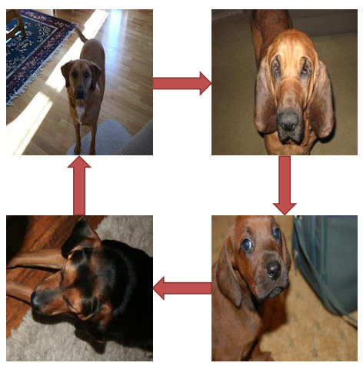
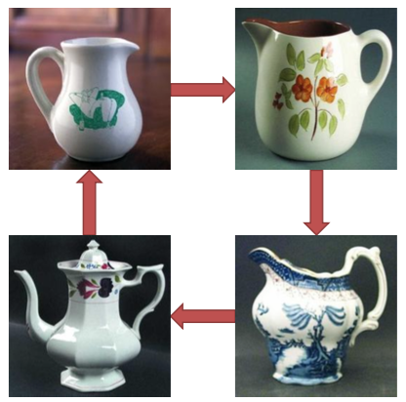
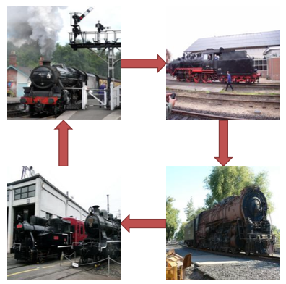
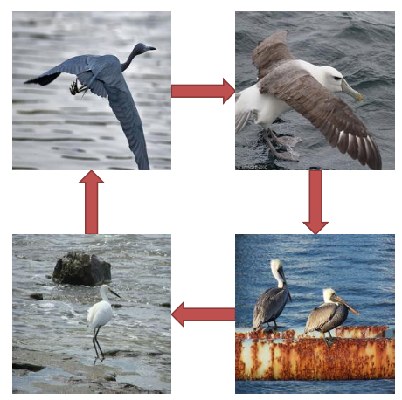
Unsupervised Feature Learning
Implementation details
Dataset: ImageNet 2012 without any labels (~1.3M images)
Base features: SIFT+FV
Mining results: ~1M positives and ~13M negatives
Cycle detection results
Positive pairs with large appearance variations
Notes:
In the setting of unsupervised feature learning, we use the proposed unsupervised constraint mining algorithm to mine positive and negative pairs from the ImageNet 2012 dataset without any labels. We use Fisher Vectors based on dense SIFT as feature descriptors to construct the graph. In total, our method mines around 1 million positive pairs and around 13 million negative pairs.
We show sampled cycle detection results. Cycle consistency helps mine positive image pairs with large appearance variations, e.g., dogs/birds under different poses, mugs under different shapes, trains under different viewpoints.

Slide 13
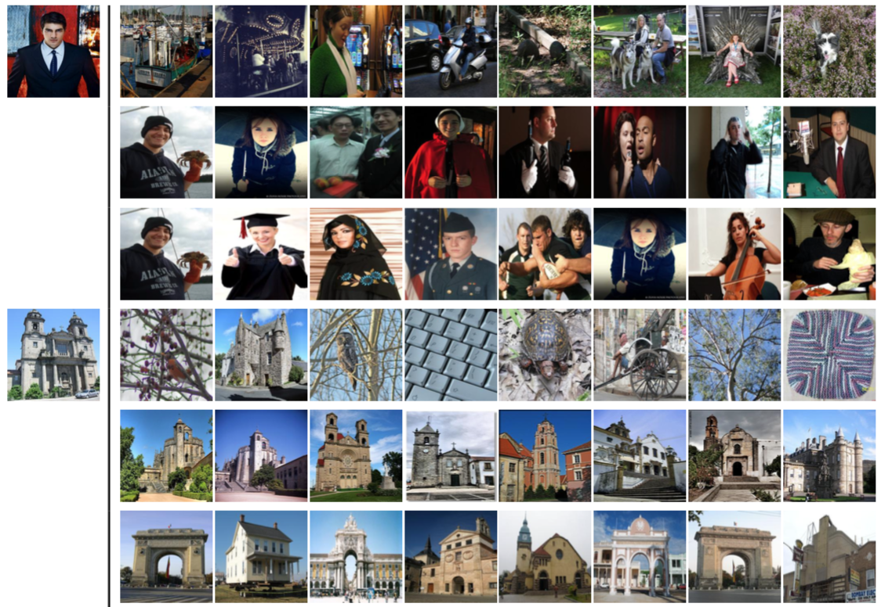
Qualitative evaluation - Search
Random
Supervised
Unsupervised
Random
Supervised
Unsupervised
Comparable to supervised learned representations
Notes:
We show examples of nearest neighbor search results using different feature representations. For each query, the three rows show the top 8 nearest neighbors obtained by AlexNet with random parameters, AlexNet trained with full supervision, and AlexNet trained using our unsupervised method, respectively. FC7 features are used to compute Euclidean distance for all the three methods. Our unsupervised method obtains similar retrieval results with the supervised pre-trained AlexNet for different types of visual categories.

Slide 14
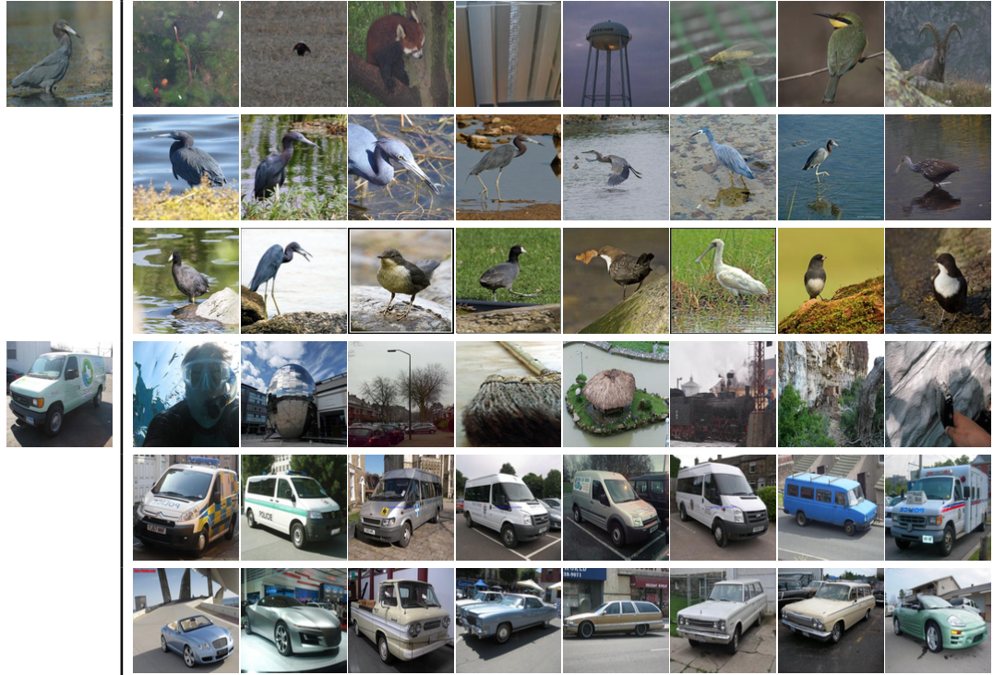
Qualitative evaluation - Search
Random
Supervised
Unsupervised
Random
Supervised
Unsupervised
Comparable to supervised learned representations
Notes:
We show examples of nearest neighbor search results using different feature representations. For each query, the three rows show the top 8 nearest neighbors obtained by AlexNet with random parameters, AlexNet trained with full supervision, and AlexNet trained using our unsupervised method, respectively. FC7 features are used to compute Euclidean distance for all the three methods. Our unsupervised method obtains similar retrieval results with the supervised pre-trained AlexNet for different types of visual categories.

Slide 15
Quantitative Evaluation - Classification
Comparisons of image classification performance on VOC 2007
Methods | Supervision | Classification
Agrawal et al. ICCV’15 | Ego-motion | 52.9
Doersch et al. ICCV’15 | Context | 55.3
Wang et al. ICCV’15 | Tracking triplet | 58.4
Ours (SIFT+FV) | Matching pair | 46.0
Ours (Learned features) | Matching pair | 56.5
Krizhevsky et al. NIPS’12 | Class labels | 69.5
Competitive performance with the state-of-the-arts
Significant improvement over hand-crafted features
Notes:
We compare the proposed unsupervised feature learning method with several state-of-the-art approaches for image classification on VOC 2007. All the results are obtained by fine-tuning using the VOC 2007 training data. We achieve competitive performance with the state-of-the-art unsupervised approaches.
We compare the classification performance using SIFT+FV and our learned features. Our learned features significantly outperform SIFT+FV by 10.5 points (56.5% vs. 46.0%). The results show that we do not train the network to replicate hand-crafted features although we use hand-crafted features to construct the graph.

Slide 16
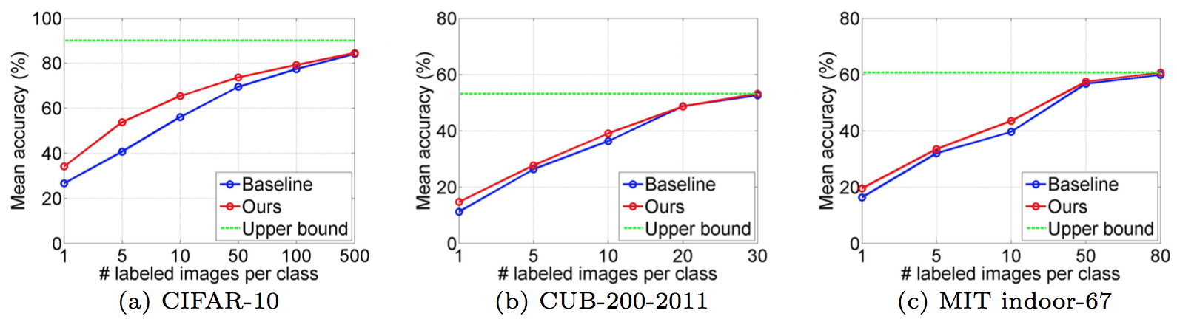
Semi-supervised Learning
Classification results on three vision datasets
True positive rate on three vision datasets
 | CIFAR-10 | CUB-200-2011 | MIT indoor-67
Random sampling | 10.0 | 0.5 | 1.5
4-cycle | 83.0 | 55.8 | 65.8
Accurate positive pairs despite small inter-class differences
Notes:
In the setting of of semi-supervised learning, we use three datasets to evaluate the recognition performance: (1) CIFAR-10 for object recognition, (2) CUB- 200-2011 for fine-grained recognition and (3) MIT indoor-67 for scene recognition. For the three datasets used, we randomly select several images per class on the training set as the partial annotated data.
Compared to directly fine-tuning by the limited labeled data, we obtain boosted classification performance using our mined constraints. The results demonstrate that our unsupervised constraint mining algorithm provides new useful constraints beyond annotations and helps better transfer the pre-trained network for visual recognition.
Using 4-cycle constraints, we obtain positive pairs with high true positive rate on the three datasets. The results demonstrate that our method can generate accurate image pairs despite small inter-class differences among visual categories.

Slide 17
Conclusions
Unsupervised constraint mining
Positive mining: positive pairs with large appearance variations
Negative mining: hard negative pairs with a relatively small L2 distance
Cycle consistency → Positive mining
Geodesic distance → Negative mining
Unsupervised feature leaning
Image search: comparable to supervised learned representations
Image classification: competitive with the state-of-the-arts
Semi-supervised leaning
Image classification: boosted performance over directly fine-tuning
Notes:
In this work, we propose to leverage graph-based analysis to mine constraints from an unlabeled image collection for visual representation learning. We use a cycle consistency criterion to mine positive image pairs and geodesic distance to mine hard negative samples. The proposed unsupervised constraint mining method is applied to both unsupervised feature learning and semi-supervised learning. We believe that our method provides new insights into data mining, unsupervised feature learning, and semi-supervised learning, and has broad applications for large-scale recognition tasks.

